Slide 1
Discriminant Analysis
An Introduction

Slide 2
Problem description
We wish to predict group membership for a number of subjects from a set of predictor variables.
The criterion variable (also called grouping variable) is the object of classification. This is ALWAYS a categorical variable!!!
Simple case: two groups and p predictor variables.

Slide 3
Example
We want to know whether somebody has lung cancer. Hence, we wish to predict a yes or no outcome.
Possible predictor variables: number of cigarettes smoked a day, caughing frequency and intensity etc.

Slide 4
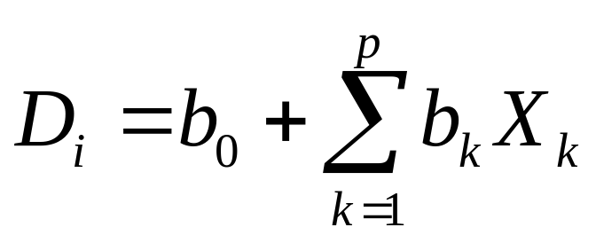
Approach (1)
Linear discriminant analysis constructs one or more discriminant equations D_{i} (linear combinations of the predictor variables X_{k}) such that the different groups differ as much as possible on D.
Discriminant function:

Slide 5
Approach (2)
More precisely, the weights of the discriminant function are calculated in such a way, that the ratio (between groups SS)/(within groups SS) is as large as possible.
Number of discriminant functions = min(number of groups – 1,p).

Slide 6
Definitions
Suppose we have a set of g classes.
Let W denote the within-class covariance matrix, that is the covariance matrix of the variables centered on the class mean.
B denote the between-classes covariance matrix, that is, of the predictions by the class means.
The sample covariances are:

Slide 7
Interpretation
First discriminant function D₁ distinguishes first group from groups 2,3,..N.
Second discriminant function D₂ distinguishes second group from groups 3, 4…,N.
etc

Slide 8
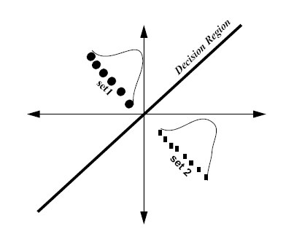
Visualization (two outcomes)

Slide 9
Visualization (3 outcomes)

Slide 10
Approach (3)
To calculate the optimal weights, a training set is used containing the correct classification for a group of subjects.
EXAMPLE (lung cancer):
We need data about persons for whom we know for sure that they had lung cancer (e.g. established by means of an operation, scan, or xrays)!

Slide 11
Approach (4)
For a new group of subjects for whom we do not yet know the group they belong to, we can use the previously calculated discriminant weights to obtain their discriminant scores.
We call this “classification”.

Slide 12
Technical details
The calculation of optimal discriminant weights involves some mathematics.

Slide 13
Example (1)
The famous (Fisher's or Anderson's) iris data set gives the measurements in centimeters of the variables sepal length and width and petal length and width, respectively, for 50 flowers from each of 3 species of iris.
The species are Iris setosa, versicolor, and virginica.

Slide 14
Fragment of data set
Obs S.Length S.Width P.Length P.Width Species
1 5.1 3.5 1.4 0.2 setosa
2 4.9 3.0 1.4 0.2 setosa
3 4.7 3.2 1.3 0.2 setosa
4 4.6 3.1 1.5 0.2 setosa
5 5.0 3.6 1.4 0.2 setosa
6 5.4 3.9 1.7 0.4 setosa
7 4.6 3.4 1.4 0.3 setosa
8 5.0 3.4 1.5 0.2 setosa
9 4.4 2.9 1.4 0.2 setosa

Slide 15
Example (2)
Dependent variable?
Predictor variables?
Number of discriminant functions?

Slide 16
Step 1: Analyze data
The idea is to start with analyzing the data.
We start with linear discriminant analysis.
Do the predictors vary sufficiently over the different groups?
If not, they will be bad predictors.
Formal test for this: Wilks’ test
This test assesses whether the predictors vary enough to distinguish different groups.

Slide 17
Step 1a: Sample statistics
Call:
iris.lda<-lda(Species ~ Sepal.Length + Sepal.Width + Petal.Length + Petal.Width, data = iris)
Prior probabilities of groups:
setosa versicolor virginica
0.3333333 0.3333333 0.3333333
Group means:
Sepal.Length Sepal.Width Petal.Length Petal.Width
setosa 5.006 3.428 1.462 0.246
versicolor 5.936 2.770 4.260 1.326
virginica 6.588 2.974 5.552 2.026
Coefficients of linear discriminants:
LD1 LD2
Sepal.Length 0.8293776 0.02410215
Sepal.Width 1.5344731 2.16452123
Petal.Length -2.2012117 -0.93192121
Petal.Width -2.8104603 2.83918785
Proportion of trace:
LD1 LD2
0.9912 0.0088

Slide 18
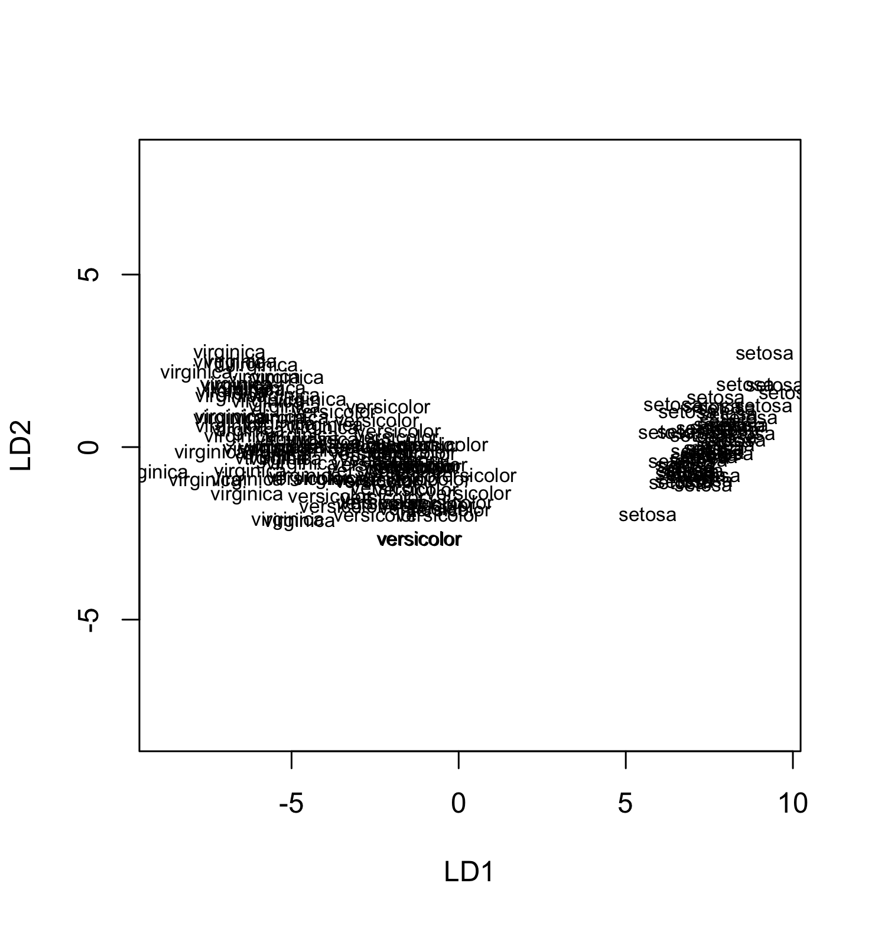
Visualization
plot(iris.lda)

Slide 19
Step 1b: Formal test
X<-as.matrix(iris[-5])
iris.manova<-manova(X~iris$Species)
iris.wilks<-summary(iris.manova,test="Wilks")
Relevant output: Wilks’ lamba equals 0.023, with p-value 2.2e-16.
Thus, at a 0.001 significance level, we do not reject the discriminant model.
(yes!, we are happy!)

Slide 20
Step 2: Discriminant function (1)
Look at the coefficients of the standardized (!) discriminant functions to see what predictors play an important role.
The larger the coefficient of a predictor in the standardized discriminant function, the more important its role in the discriminant function.

Slide 21
Step 2: Discriminant function (2)
The coefficients represent partial correlations:
the contribution of a variable to the discriminant function in the context of the other predictor variables in the model.
Limitations: with more than two outcomes more difficult to interpret.

Slide 22
Step 2: Getting discr. functions
Call:
iris.lda<-lda(Species ~ Sepal.Length + Sepal.Width + Petal.Length + Petal.Width, data = iris)
Prior probabilities of groups:
setosa versicolor virginica
0.3333333 0.3333333 0.3333333
Group means:
Sepal.Length Sepal.Width Petal.Length Petal.Width
setosa 5.006 3.428 1.462 0.246
versicolor 5.936 2.770 4.260 1.326
virginica 6.588 2.974 5.552 2.026
Coefficients of linear discriminants:
LD1 LD2
Sepal.Length 0.8293776 0.02410215
Sepal.Width 1.5344731 2.16452123
Petal.Length -2.2012117 -0.93192121
Petal.Width -2.8104603 2.83918785
Proportion of trace:
STANDARDIZED!!!!
LD1 LD2
0.9912 0.0088

Slide 23
Step 3: Comparing discr. funcs
Which discriminant function has most discriminating power?
Look at the “eigenvalues”, also called the “singular values” or “characteristic roots”. Each discriminant function has such a value. They reflect the amount of variance explained in the grouping variable by the predictors in a discriminant function.
Always look at the ratio of the eigenvalues to assess the relative importance of a discriminant function.

Slide 24
Step 3: Getting eigenvalues
iris.lda$svd
> iris.lda$svd
[1] 48.642644 4.579983
svd: the singular values, which give the ratio of the between- and within-group standard deviations on the linear discriminant variables.
belongs to D1
belongs to D2

Slide 25
Step 4: More interpretation
Trace
Useful plots
Group centroids

Slide 26
Step 4a: Trace
Call:
iris.lda<-lda(Species ~ Sepal.Length + Sepal.Width + Petal.Length + Petal.Width, data = iris)
Prior probabilities of groups:
setosa versicolor virginica
0.3333333 0.3333333 0.3333333
Group means:
Sepal.Length Sepal.Width Petal.Length Petal.Width
setosa 5.006 3.428 1.462 0.246
versicolor 5.936 2.770 4.260 1.326
virginica 6.588 2.974 5.552 2.026
Coefficients of linear discriminants:
LD1 LD2
Sepal.Length 0.8293776 0.02410215
Sepal.Width 1.5344731 2.16452123
Petal.Length -2.2012117 -0.93192121
Petal.Width -2.8104603 2.83918785
Proportion of trace:
LD1 LD2
0.9912 0.0088

Slide 27
Step 4a: Trace interpretation
The first trace number indicates the percentage of between-group variance that the first discriminant function is able to explain from the total amount of between-group variance.
High trace number = discriminant function plays an important role!

Slide 28
Step 4b: Useful plots
Take e.g. first and second discriminant function. Plot discriminant function values of objects in scatter plot, with predicted groups. Does the discriminant function discriminate well between the different groups?
Combine plot with “group centroids”. (Average values of discriminant functions for each group)

Slide 29
Step 4c: R code for plot
# Plot
LD1<-predict(iris.lda)$x[,1]
LD2<-predict(iris.lda)$x[,2]
plot(LD1,LD2,xlab="first linear discriminant",ylab="second linear discriminant",type="n")
text(cbind(LD1,LD2),labels=unclass(iris$Species))
# 1="setosa"
# 2="versicolor"
# 3="virginica"
# Group centroids
sum(LD1*(iris$Species=="setosa"))/sum(iris$Species=="setosa")
sum(LD2*(iris$Species=="setosa"))/sum(iris$Species=="setosa")
sum(LD1*(iris$Species=="versicolor"))/sum(iris$Species=="versicolor")
sum(LD2*(iris$Species=="versicolor"))/sum(iris$Species=="versicolor")
sum(LD1*(iris$Species=="virginica"))/sum(iris$Species=="virginica")
sum(LD2*(iris$Species=="virginica"))/sum(iris$Species=="virginica")

Slide 30
Step 5: Prediction (1)
Using the estimated discriminant model, classify new subjects.
Various ways to do this.
We consider the following approach:
  Calculate the probability that a subject belongs to a certain group using the estimated discriminant model.
  Do this for all groups.
  Classification rule: subject is assigned to group it has the highest probability to fall into.

Slide 31
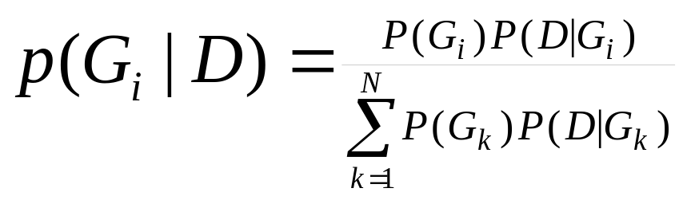
Step 5: Bayes rule
Formula used to calculate probability that a subject belongs to a group:
“priors”

Slide 32
Step 5: Prediction (2)
To determine these probabilities, a “prior probability” is required. These priors represent the probability that a subject belongs to a particular groups.
Usually, we set them equal to the fraction of subjects in a particular group.

Slide 33
Step 5: Prediction (3)
Prediction on training set: to assess how well the discriminant model predicts.
Prediction on a new data set: to predict the group new object belongs to.

Slide 34
Step 5: Prediction in R
iris.predict<-predict(iris.lda,iris[,1:4])
Predict class for all objects.
iris.classify<-iris.predict$class
Get predicted class for all objects.
iris.classperc<-sum(iris.classify==iris[,5])/150
Calculate % correctly classified objects.
Priors are set automatically, but you can set them manually as well if you want.

Slide 35
Step 5: Quality of prediction (1)
To assess the quality of a prediction, make a prediction table.
Rows with observed categories of dependent variable, columns with forecasted categories.
Ideally, the off-diagonal elements should be zero.

Slide 36
Step 5: Quality of prediction (2)
The percentage correctly classified objects is usually compared to
  the “random” classification
  (100/N)% probability in group i=1,…,N.
  the “probability matching” classifcation
  Probability of assigning group i=1,…,N to an object is equal to the fraction of objects in class i.

Slide 37
Step 5: Quality of prediction (3)
  the “probability maximizing” method.
  Put all subjects in the most likely category (i.e. the category with the highest fraction of objects in it).

Slide 38
Step 5: Get table in R
table(Original=iris$Species,Predicted=
predict(iris.lda)$class)
Predicted
Original setosa versicolor virginica
setosa 50 0 0
versicolor 0 48 2
virginica 0 1 49
Grouping variable
Predicted classes

Slide 39
Step 6: Structure coefficients
Correlations between predictors and discriminant values indicate which predictor is most related to discriminant function (not corrected for the other variables)
Example: cor(iris[,1],LD1)
(Note difference with discriminant coefficients!!!)

Slide 40
Assumptions underlying LDA
Independent subjects.
Normality: the variance-covariance matrix of the predictors is the same in all groups.
If the latter assumption is violated: use quadratic discriminant analysis in the same manner as linear discriminant analysis.
ALWAYS CHECK YOUR ASSUMPTIONS…….

Slide 41
Quadratic discriminant analysis
Call qda: result <- qda(y∼x1+x2,example,prior=c(.5,.5))
Obtain a classiﬁcation of the training sample and compute the confusion matrix
pr <- predict(result,examplex)
yhat <- pr$class table(y,yhat)
table(y,yhat)
Result for training data
yhat
y 1 2
1 11 1
2 2 10
CV for testing data:
result <- qda(y ∼x1+x2,example,prior=c(.5,.5),CV=TRUE)
yhatcv <- result$class

